Slide 1

PREDICTING STOCK PRICE MOVEMENT USING SENTIMENT ANALYSIS
Request for problem:
Delta Capital & Financial Services

Slide 2
Table of contents
01
02
03
04
05
Introduction
06
Data Sources
Problem Framing
07
Data Analysis
Situation Analysis
08
Results & Findings
Statement of Purpose
09
Conclusion
Project Execution

Slide 3




Introduction:
Company Overview:
TCS: Global leader in IT services and consulting.
HUL: Leading FMCG company in India with a diverse product range.
Mahindra & Mahindra: Major player in the automotive sector, also involved in agribusiness.
Divi’s Laboratories: Specializes in Active Pharmaceutical Ingredients (APIs) and contract research.

Slide 4

Problem Framing:
In the rapidly evolving financial landscape, predicting stock prices is crucial for informed investment decisions.
This research aims to develop robust predictive models for Tata Consultancy Services (TCS) , Divi’s Labs, HUL, Mahindra and Mahindra by leveraging historical stock price data and analyzing sentiment from relevant news articles.
By integrating quantitative and qualitative data, we seek to enhance the accuracy of stock price movement predictions, providing valuable insights for investors.

Slide 5
Literature Review
Zhang et. al
Pagolu et al
High negative correlation between negative moods on social network and DJIA index
strong correlation between rise/fall of a company stock prices and the public emotions expressed on twitter.
Chen et al
used a model established on LSTM algorithm to predict direction of stocks in Chinese Stock Exchange, it gave higher accuracy with random estimation
Schumaker et al
Relations between breaking financial news and stock price changes

Slide 6
Statement of Purpose:
Assess sentiment-driven factors affecting stock price volatility
Investigate how market sentiment influences stock price behaviour
Analyse sentiment impact on stock prices to develop predictive models
Examine the correlation between news sentiment and stock price movements

Slide 7
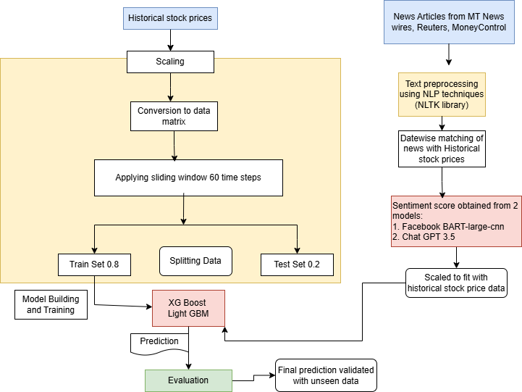
Project Execution
From Yahoo Finance

Slide 8
Model explanation
XGBoost (eXtreme Gradient Boosting) is a popular open-source gradient boosting framework that is widely used for classification and regression tasks. Its importance lies in its ability to handle large datasets and provide high accuracy results.
Light GBM
Light GBM is another popular gradient boosting framework that is designed to be highly efficient and scalable. Its importance lies in its ability to handle large datasets and provide high accuracy results.
ChatGPT 3.5
ChatGPT 3.5 is a conversational AI model developed by OpenAI that is capable of generating human-like text responses. Its importance lies in its ability to understand and respond to natural language inputs.
Facebook BART-large-cnn
BART-large-cnn is a pre-trained language model developed by Facebook that is capable of generating text summaries. Its importance lies in its ability to understand and summarize long pieces of text.

Slide 9
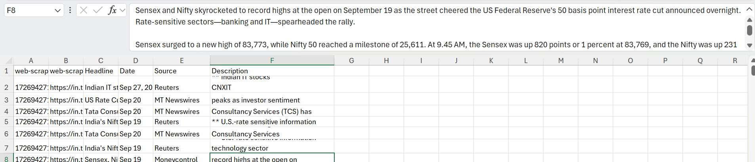
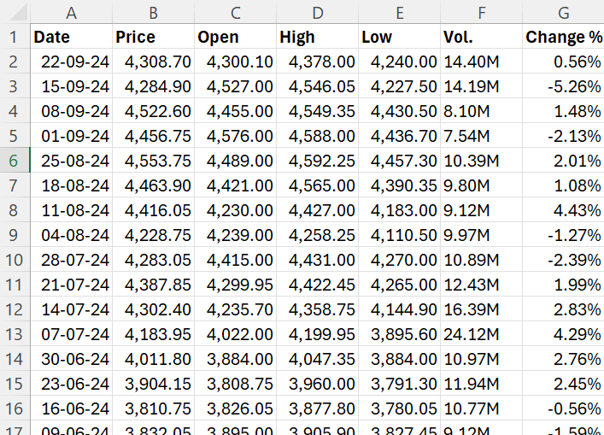
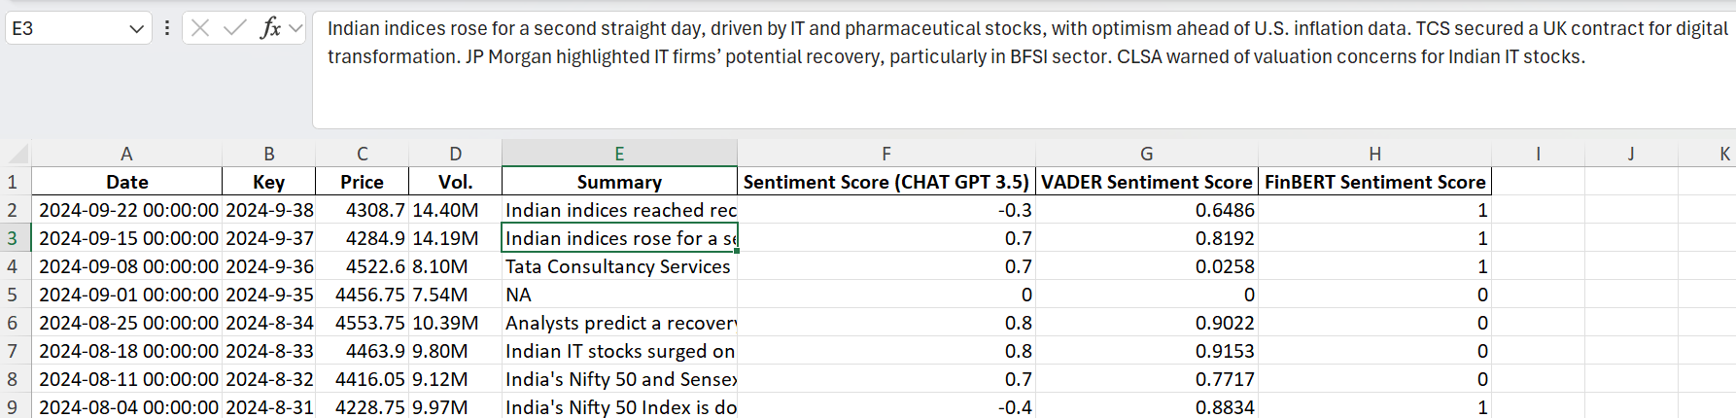
Data Sources:

Slide 10
Data Analysis:
Sentiment Scoring
Sentiment scoring using models like ChatGPT, VADER, and FinBERT
Ensemble Models
01
Emphasis on ensemble models for better predictive accuracy
Sentiment Analysis
02
Use of traditional statistical methods alongside sentiment analysis
03
News Impact
04
Sentiment analysis focused on the regulatory news impacts

Slide 11
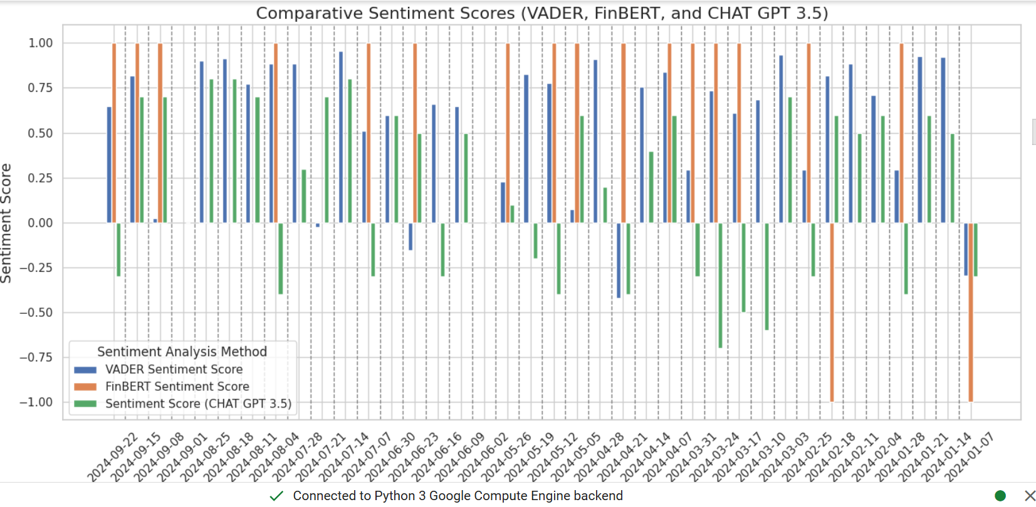
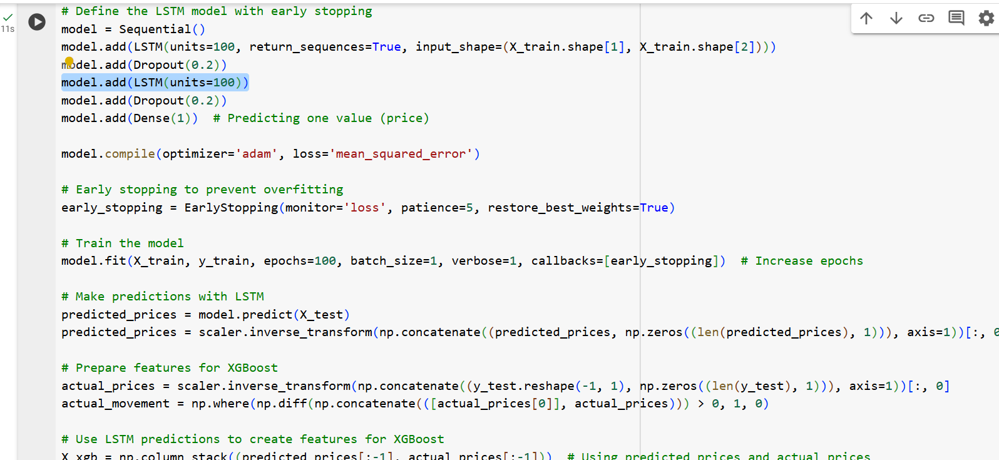
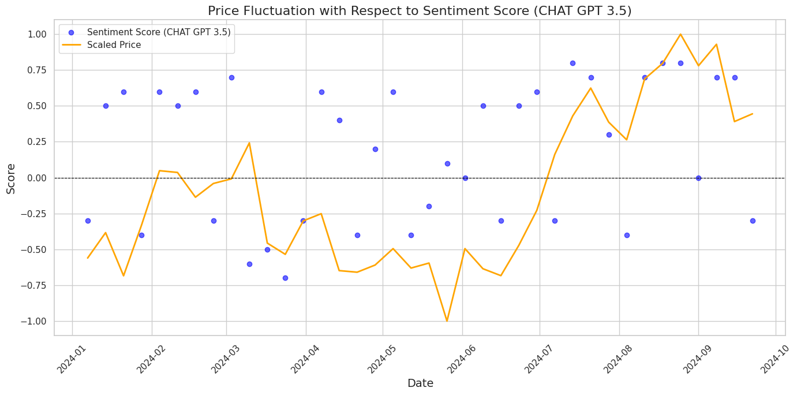
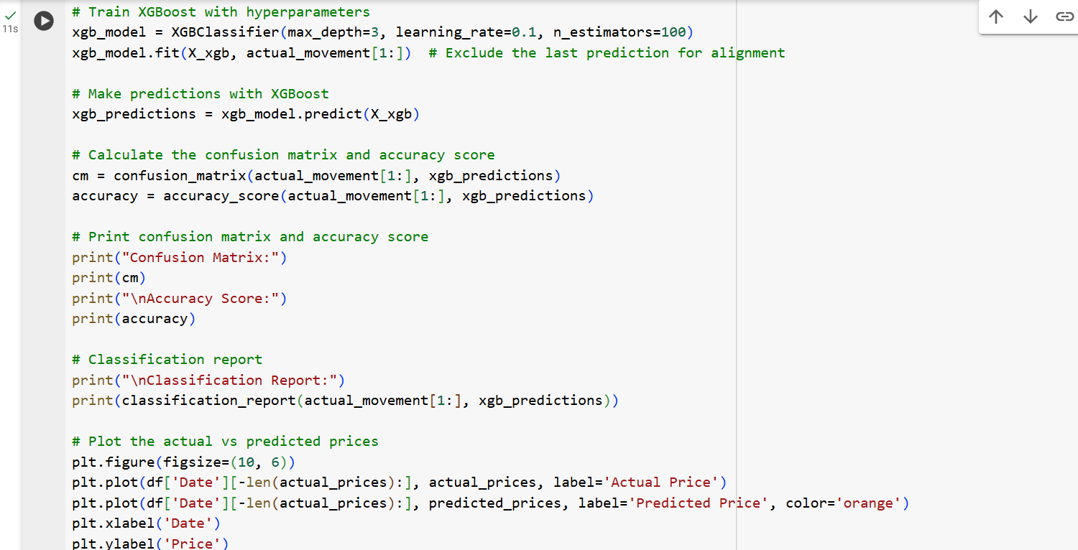

Slide 12
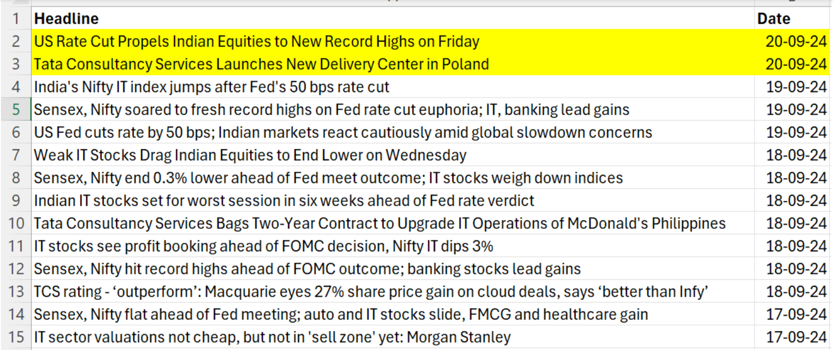
Results and Findings:
Using only 17-09-2024 to 19-09-2024 user given live news headline to predict on 20-09-2024 the price movement will go up or down.
Our model predicts It will go down, negative sentiment -0.28 .
We see that the closing price actually decreased from 4296.14 (on 19-09-2024) to 4284.89 (on 20-09-2024). Later it further decreased to 4268.50.

Slide 13
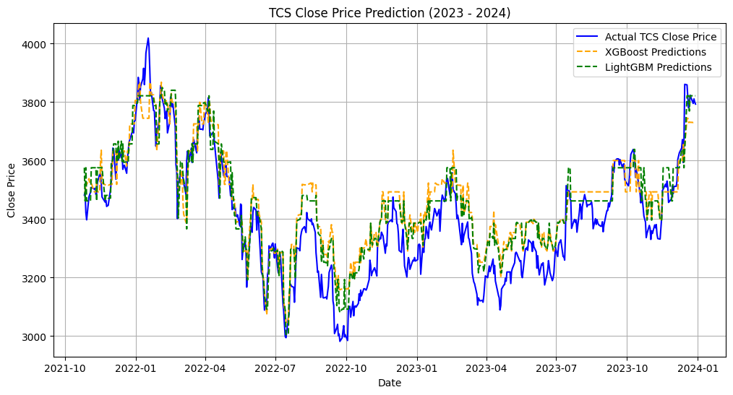
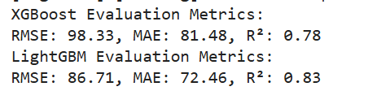
Final model prediction

Slide 14
Model Evaluation Metrics summary
RMSE Interpretation: RMSE quantifies the average magnitude of prediction errors by calculating the square root of the average squared differences between predicted and actual values. A lower RMSE indicates superior predictive accuracy. LightGBM’s RMSE indicates that its predictions deviate from actual closing prices by approximately ₹86.71 on average, whereas XGBoost shows a higher deviation of ₹98.33.
MAE Interpretation: MAE measures the average absolute differences between predicted and actual values. Unlike RMSE, which emphasizes larger errors, MAE treats all errors uniformly. LightGBM's MAE of ₹72.46 reflects a closer fit to actual prices compared to XGBoost's MAE of ₹81.48, indicating better overall accuracy.
R² Interpretation: R² assesses the proportion of variance in the dependent variable (TCS closing price) that can be explained by the independent variables. R² values range from 0 to 1, with higher values indicating a better model fit. LightGBM's R² of 0.83 suggests that it explains approximately 83% of the variance in closing prices, compared to 78% explained by XGBoost, highlighting LightGBM's superior explanatory power.

Slide 15
Conclusion:
This research highlighted the integration of historical stock prices and sentiment analysis from news articles to enhance predictive models for TCS, Divi’s Labs, HUL , Mahindra and Mahindra stocks.
By combining quantitative and qualitative data, we aimed to improve forecasting accuracy, providing investors with actionable insights for informed decision-making in a volatile financial landscape.

Slide 16
References
Chen. R and Lazer. M., Sentiment Analysis of Twitter Feeds for the Prediction of Stock Market Movement, Cs 229, pp. 15. (2011).
Pagolu, V. S., Challa, K. N. R., Panda, G., & Majhi, B. Sentiment analysis of twitter data for predicting stock market movements. http://arxiv.org/abs/1610.09225, last accessed 2016.
Schumaker, R. P., & Chen, H. Textual analysis of stock market prediction using breaking financial news: The AZFin text system. ACM Transactions on Information Systems, 27(2), 1–19. (2009).
Zhang. L., Sentiment Analysis on Twitter with Stock Price and Significant Keyword Corre lation, pp. 130. (2013).

Slide 17





Team:
Abhishek Padhy
2023JULB01063
Mayank Vishal 2023JULB01037
Parnal Khobragade 2023JULB01119
Pratik Patil 2023JULB01049
Prince Pritam 2023JULB01012

